Slide 1
Trade shows and e-business

Slide 2
Trade shows
Are often the first communicative step in SMEs’ export development
Valuable for well-known firms and new firms alike
Major drawback : costs. May be lowered if part of a road show.
Definition : a concentrated exhibition of the products of many manufacturers and exporters
2 types :
      the broad, general, annual fair (Hannover Fair)
      The specialized trade show (Paris Air Show)

Slide 3
Objectives of a trade fair
Quantitative : profits, sales (continued sales to existing customers, sales to new buyers dissatisfied with their current providers and buyers attracted to a new offering).
Qualitative :
  Contacts (customers, agents, distributors, shippers)
  market information (observing competitors, market sector, consumer behaviour, innovation, market trends, opportunities)
  target groups (end-consumers, retailers, agents etc)
  Communication (advertising message and material, fair team)

Slide 4
Monitoring trade fair success
ROI : records quantitative results
Systematic recording of contacts. Comparison with previous years.
Observation of competition : checklist (stand, size, number, products, services, staff, visitors, material)
Trade fair budget : space (25%), booth expenses (33%), show services (22%), transportation (13%), communication (4%), personnel (4%)

Slide 5
Trade shows after the pandemic
2020-21 : few trade shows. Some virtual fairs, but with fewer attendees.
Almost return to pre-pandemic level in 2024: answer the needs of face-to-face meetings.
Face-to-face meetings/zoom meetings : are complementary.
With existing clients : opportunity to schedule one-on-one appointments.
Short time span : minimizes costs of meeting clients.
With prospective clients : gives the company physical visibility among competitors.

Slide 6
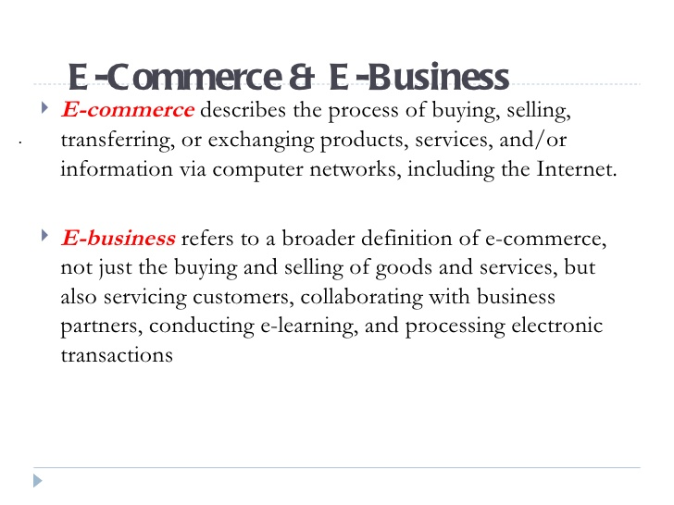

Slide 7
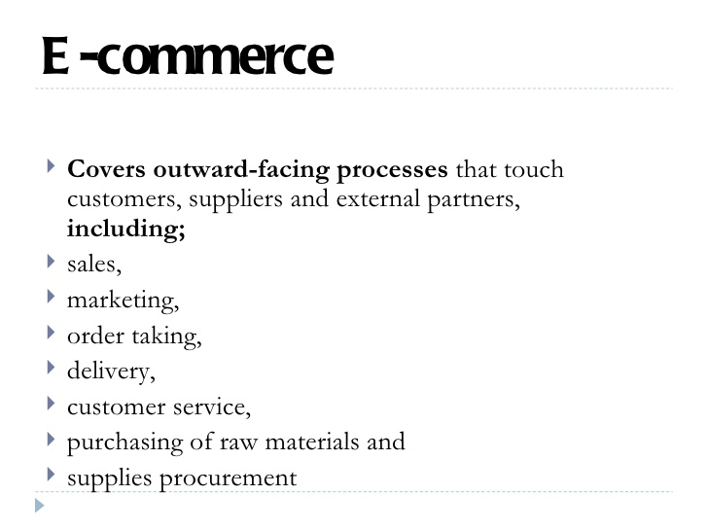

Slide 8
Why use e-commerce
Low costs of operating the website Reduces transaction costs
Access to global market:
Booming market : 2024 retail e-commerce sales exceeded 4 trillion USD.
Secure market share

Slide 9
Costs of e-commerce
Building and maintaining the website
https://www.forbes.com/advisor/business/software/how-much-does-a-website-cost/
  Initial build: $0 to $45
  Hosting and apps: $15 to $150 monthly
  Maintenance: $20 to $100 annually
Website developer’s salary
Pay-for-click
Advertising on other websites (banner advertising through advertising networks or affiliate networks; online communities)
Advertising on social media (Weibo in China, Facebook etc)

Slide 10
Types of e-commerce
B2B : the largest form. Buyer and seller similar to relation between manufacturer, wholesaler and retailer
Ex : Dell sells computers and accessories they do not always make. Buys from manufacturers.
B2C : direct trade between the company and consumers.
Often through third party sites like Tmall (Alibaba) and Amazon which also offer payment services (Alipay) and delivery.
C2C : auctions and forums where individuals can buy and sell thanks to online payment systems like PayPal. Ex : EBay auction service(since 1995)

Slide 11
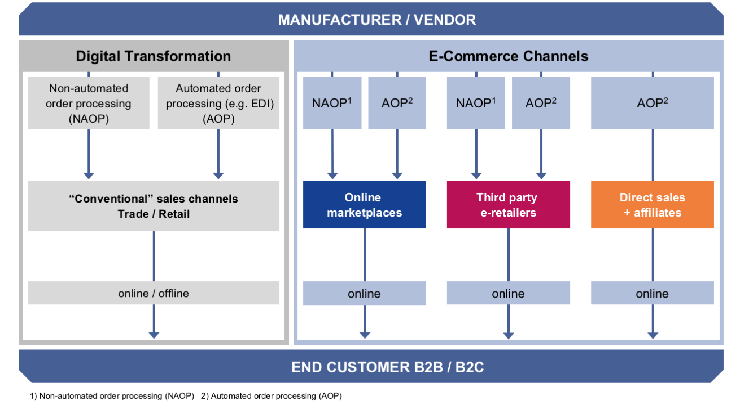

Slide 12
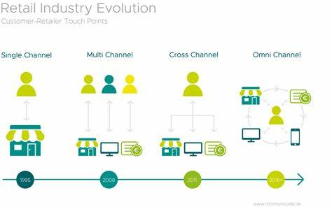

Slide 13
PROS AND CONS OF E-COMMERCE
PROS
    A booming global market : 1.67 trillion dollar market in 2016 to 4 trillion in 2024 (20% of all retail sales).
    https://www.statista.com/topics/871/online-shopping/#topicOverview
    China, a leading market (50% of global e-sales). Grows around 12% a year. Is double the size of the US market.
    See : https://ecommercechinaagency.com/what-is-the-future-of-e-commerce-in-china/
    US : market worth 1.2 trillion dollars (220bn dollars in 2016)
    For consumers : home delivery and 24-hour access

Slide 14
Risks of e-commerce
For a company : Low SEO rankings
For a company : IPR violation
Currency exchange risks
For customers : Not being able to examine the items personally
Poor customer service
Security violations, credit card theft
carbon footprint
SOLUTIONS AND STRATEGIES
Amazon bought Whole Foods in 2017 : 460 stores that can be turned into warehouses and showrooms. Fresh food home delivery is not profitable (lower volumes)
Same day delivery and returns policy
More secure payment
Delivery to parcel stations reduces the carbon footprint.

Slide 15
Trends in 2026 5 tendances e-commerce en 2026 et leurs impacts sur les infrastructures de vente en ligne
The agentic commerce revolution . Tomorrow, conversational assistants will no longer be content with simply answering questions: they will compare offers, make recommendations, and trigger purchases in a semi-autonomous manner.
Search engine optimization is not disappearing, it is transforming: optimization for search engines is giving way to optimization for AI.
The explosion of B2B commerce At the same time, B2B e-commerce is establishing itself as one of the main growth drivers in the sector.
The central role of the e-commerce site in the purchasing journey is waning. In an ecosystem where commerce is fully distributed, consumers discover an offer on a social network, compare it using an AI assistant, finalize their purchase on their mobile device, and opt for in-store pickup or return.
Logistics and data as strategic levers. Delivery promises, returns management, and product availability now directly influence purchasing decisions and loyalty.
More than just a marketing asset, data is becoming a matter of sovereignty and competitiveness. Companies must be able to collect, structure, and leverage their customer, product, and transaction data without losing control to third-party platforms.

